Slide 1
US Heart Disease Analysis for 2014
Mary Alice Salazar
Kaushik Sanaddar
Prasanna Jaiswal
DG OMG BRO

Slide 2
Motivation & Summary
We looked at heart disease because it is the number one cause of death in the United States.
According to the CDC:
About 610,000 people die of heart disease in the United States every year–that’s 1 in every 4 deaths
Heart disease is the leading cause of death for both men and women. More than half of the deaths due to heart disease in 2009 were in men
https://www.cdc.gov/heartdisease/facts.htm
We found that there is a high number of occurrence of heart disease in every state. We drilled down on gender, poverty, obesity and risk factors such as smoking, alcohol consumption, high school obesity, and adult obesity. We also found a strong correlation between the risk factors and data values.

Slide 3
Data Sources and Questions
Data sources:
Data.gov: Heart_Disease_Mortality_Data 2014
CDC: Heart Disease Death Rates (2014)
US census 2014
Questions :
What is the rate of heart disease among the US population?
Is there a difference in occurrence for gender, poverty, and other groups?
What are possible causes? i.e. smoking, alcohol, adult obesity, high school obesity?
These data sources contained data for each of these questions.
From the first, we gained information about gender
From the second data source, we gained data for mortality and risk factors.
From the census, we found poverty data.

Slide 4
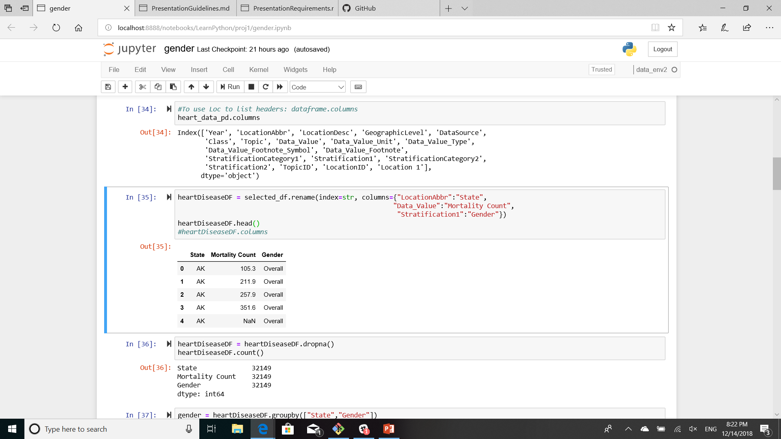
Data cleanup and exploration
We did minor cleanup on the data. There were some renamed columns, and we sliced the csv columns. For example, different data sources had different nomenclature for the states. We picked good sources.

Slide 5
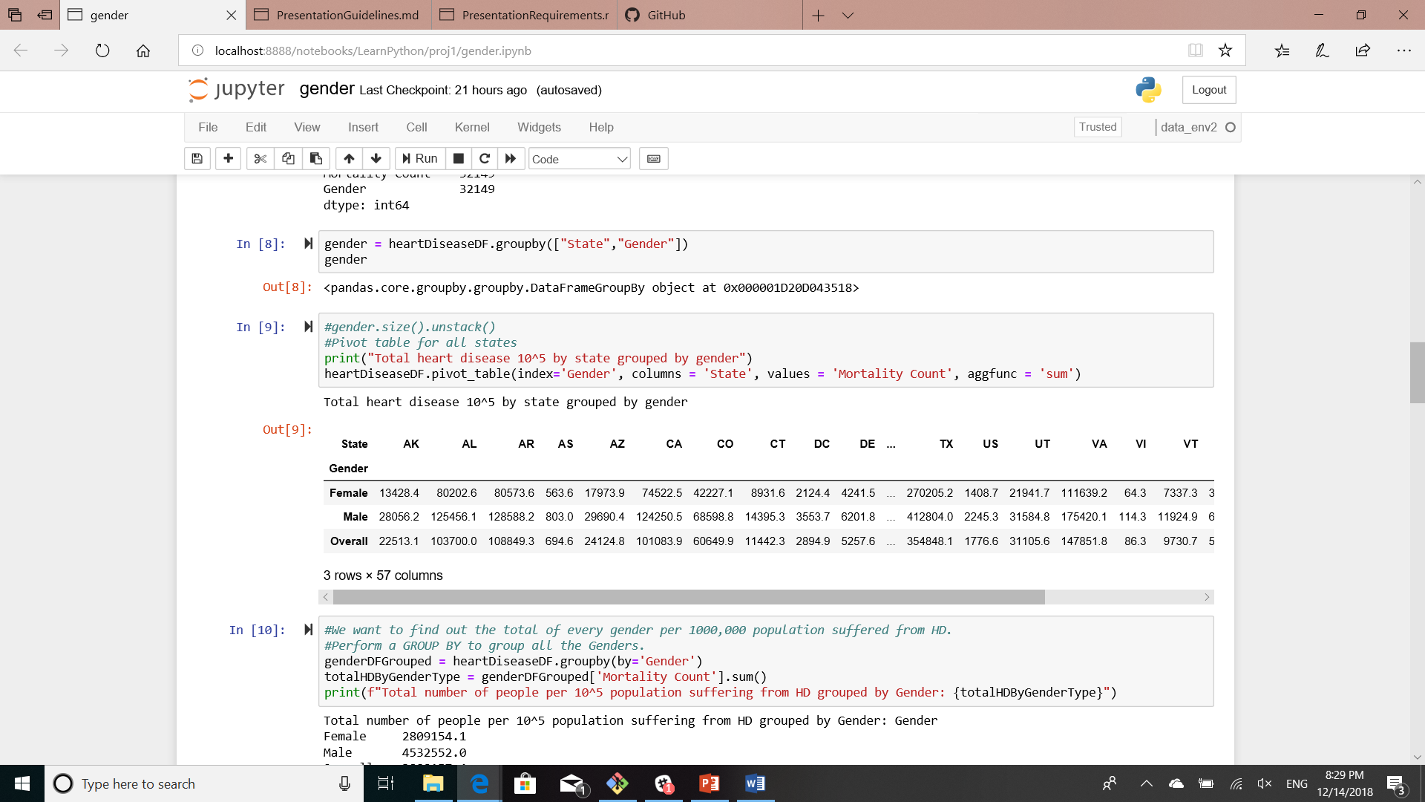
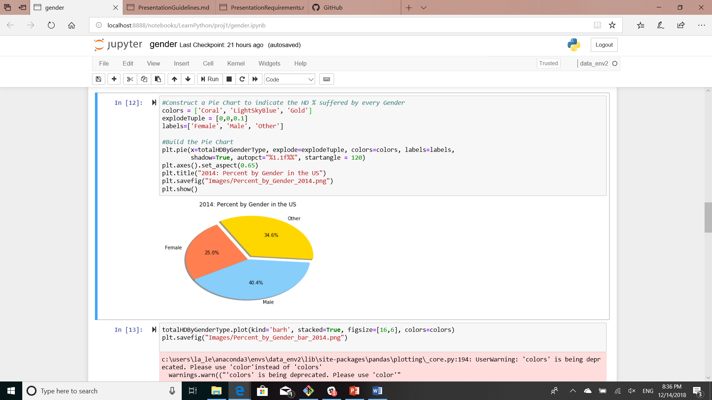
Pivot table and pie: gender

Slide 6
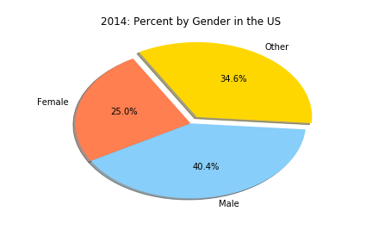
Males had a higher occurrence of heart disease in US

Slide 7
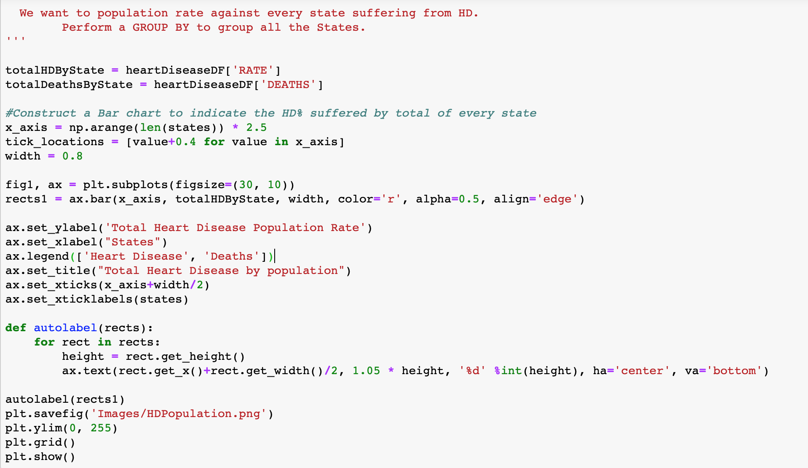
Heart Disease Analysis by States

Slide 8
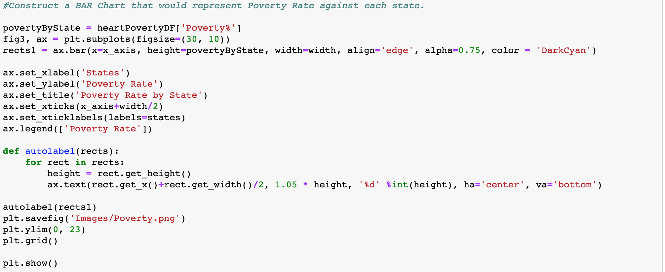
Poverty Rate by State

Slide 9
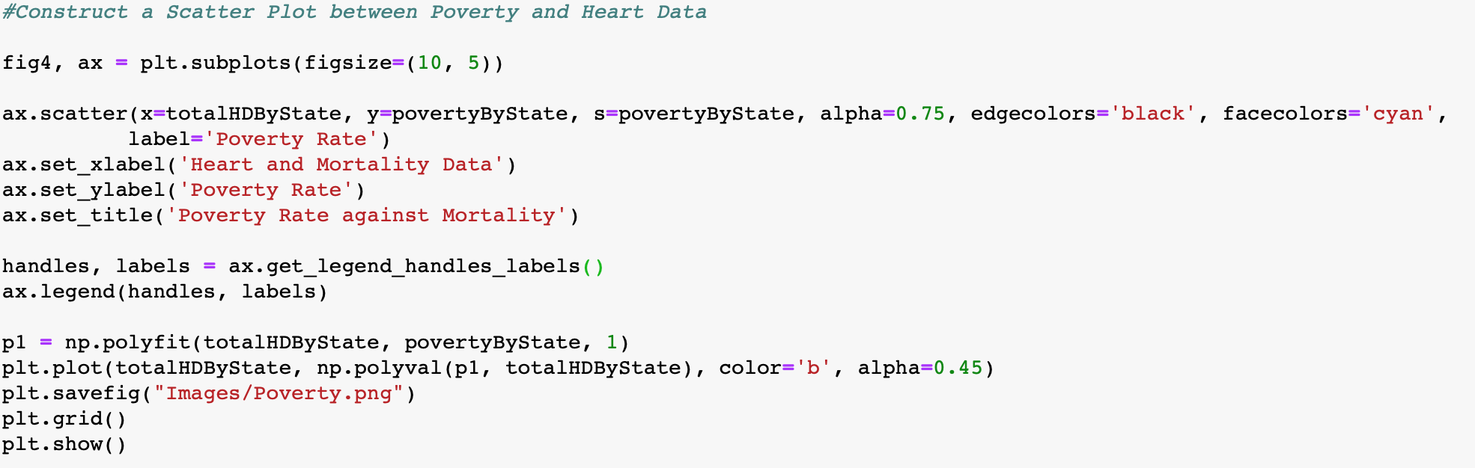
Poverty Rate by Mortality

Slide 10
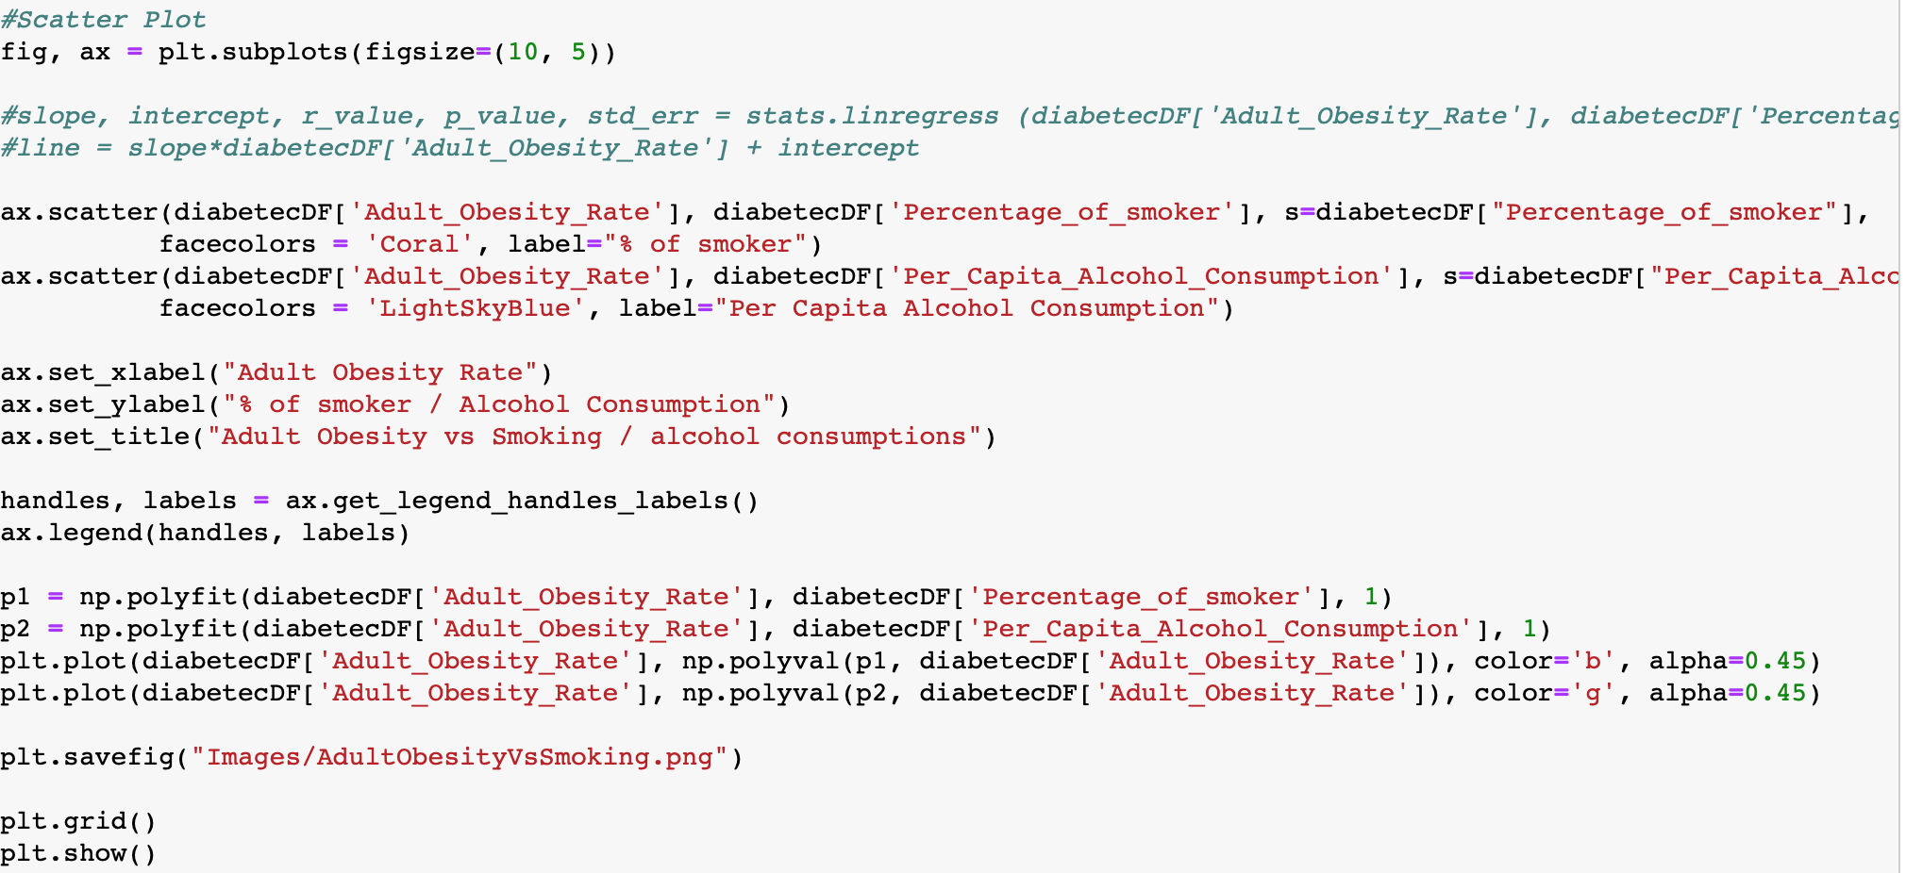
Adult Obesity Vs Smoking / Alcohol

Slide 11
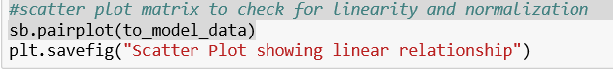
Analyzing Diabetic Cause Relation

Slide 12
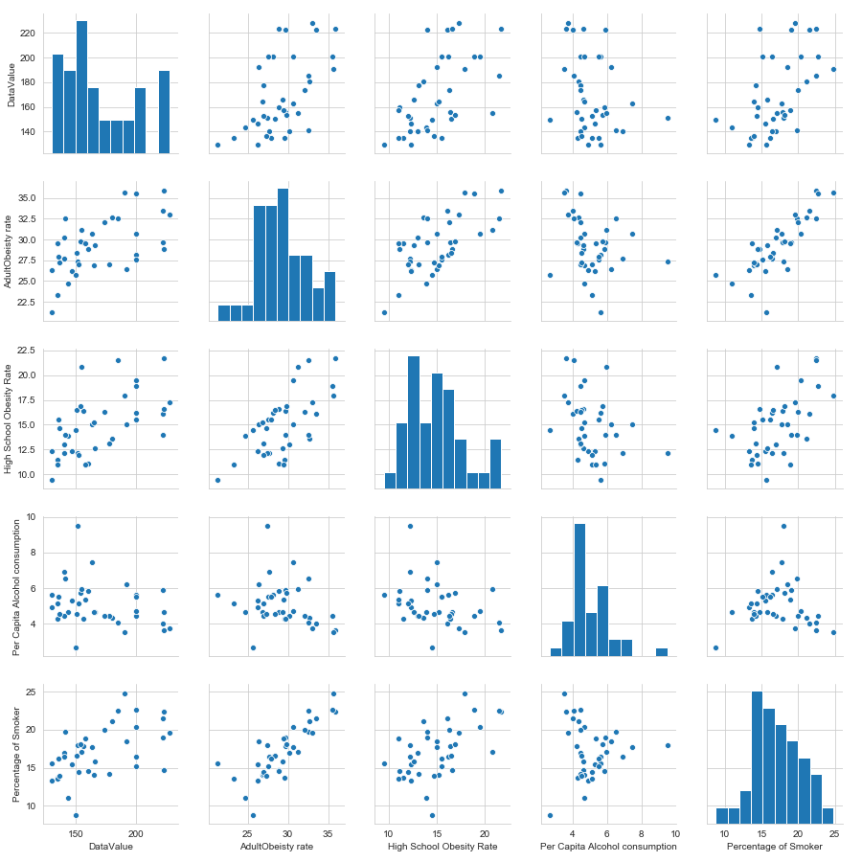
Checking for Normalization and Linearity

Slide 13
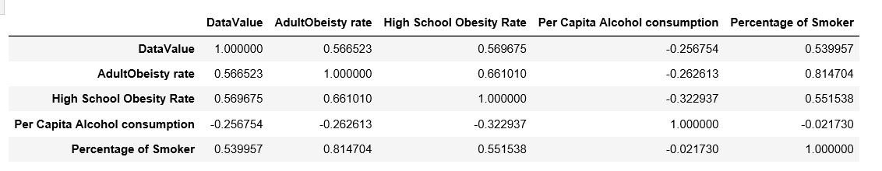
Correlation Coefficient Value (R Value)
#Calculate Pearson correlation Coefficent
corr = test_new.corr()
corr.to_csv('Correlation Values.csv')
corr

Slide 14
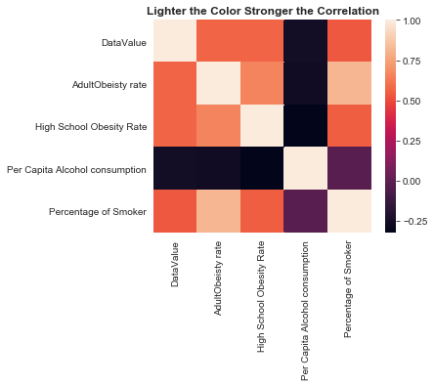
Correlation Coefficient

Slide 15
Observations
Males have a greater % of heart disease rate than the females.
The top 3 states with Heart Disease are Mississippi, Oklahoma and Alabama.
The bottom 3 states with Heart Disease are Minnesota, Oregon and Colorado.
There is a linear relationship between poverty rate and Heart / Mortality rate.
The R values indicate people who smoke more tend to be more Obese.
The R values also indicate that High School Students who are obese tend to more likely to be Obese if they continue with the lifestyle.

Slide 16
Further Research
Considered additional years to understand trend over time for all the factors.
Consider additional factors such as Nutrition, Education, % of grocery stores etc.
Heatmap visualization of the data.
Created Models to demonstrate top 5 causes.

Slide 17
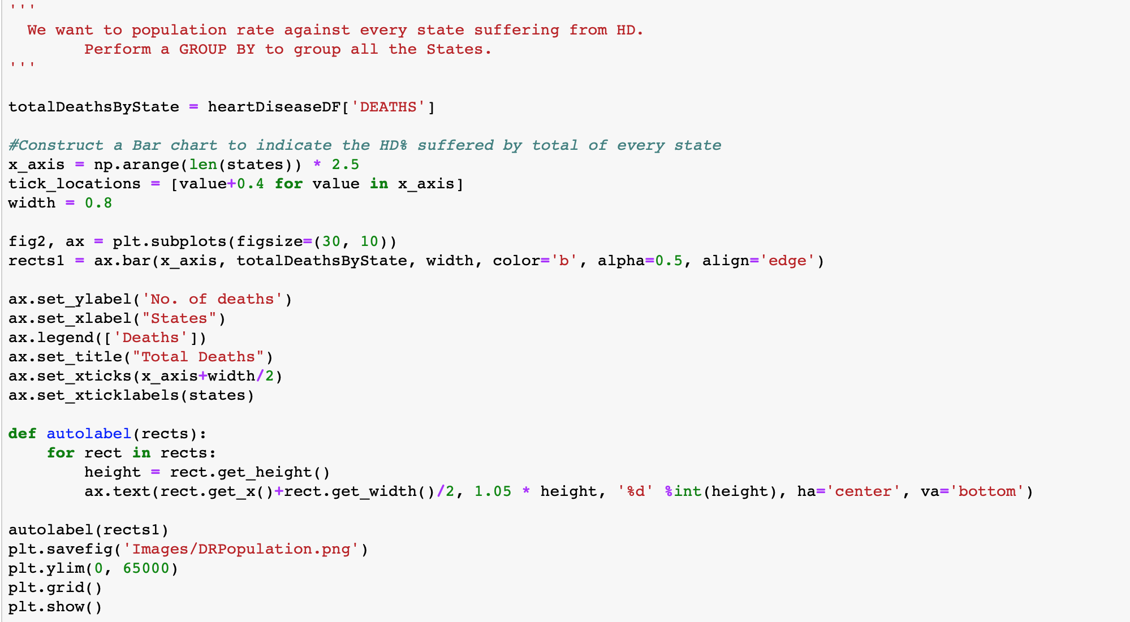
Death by State

